Slide 1
DEPI - 2
Digital Arts - Mastering Professional 3D Designs
2024-2025

Slide 2
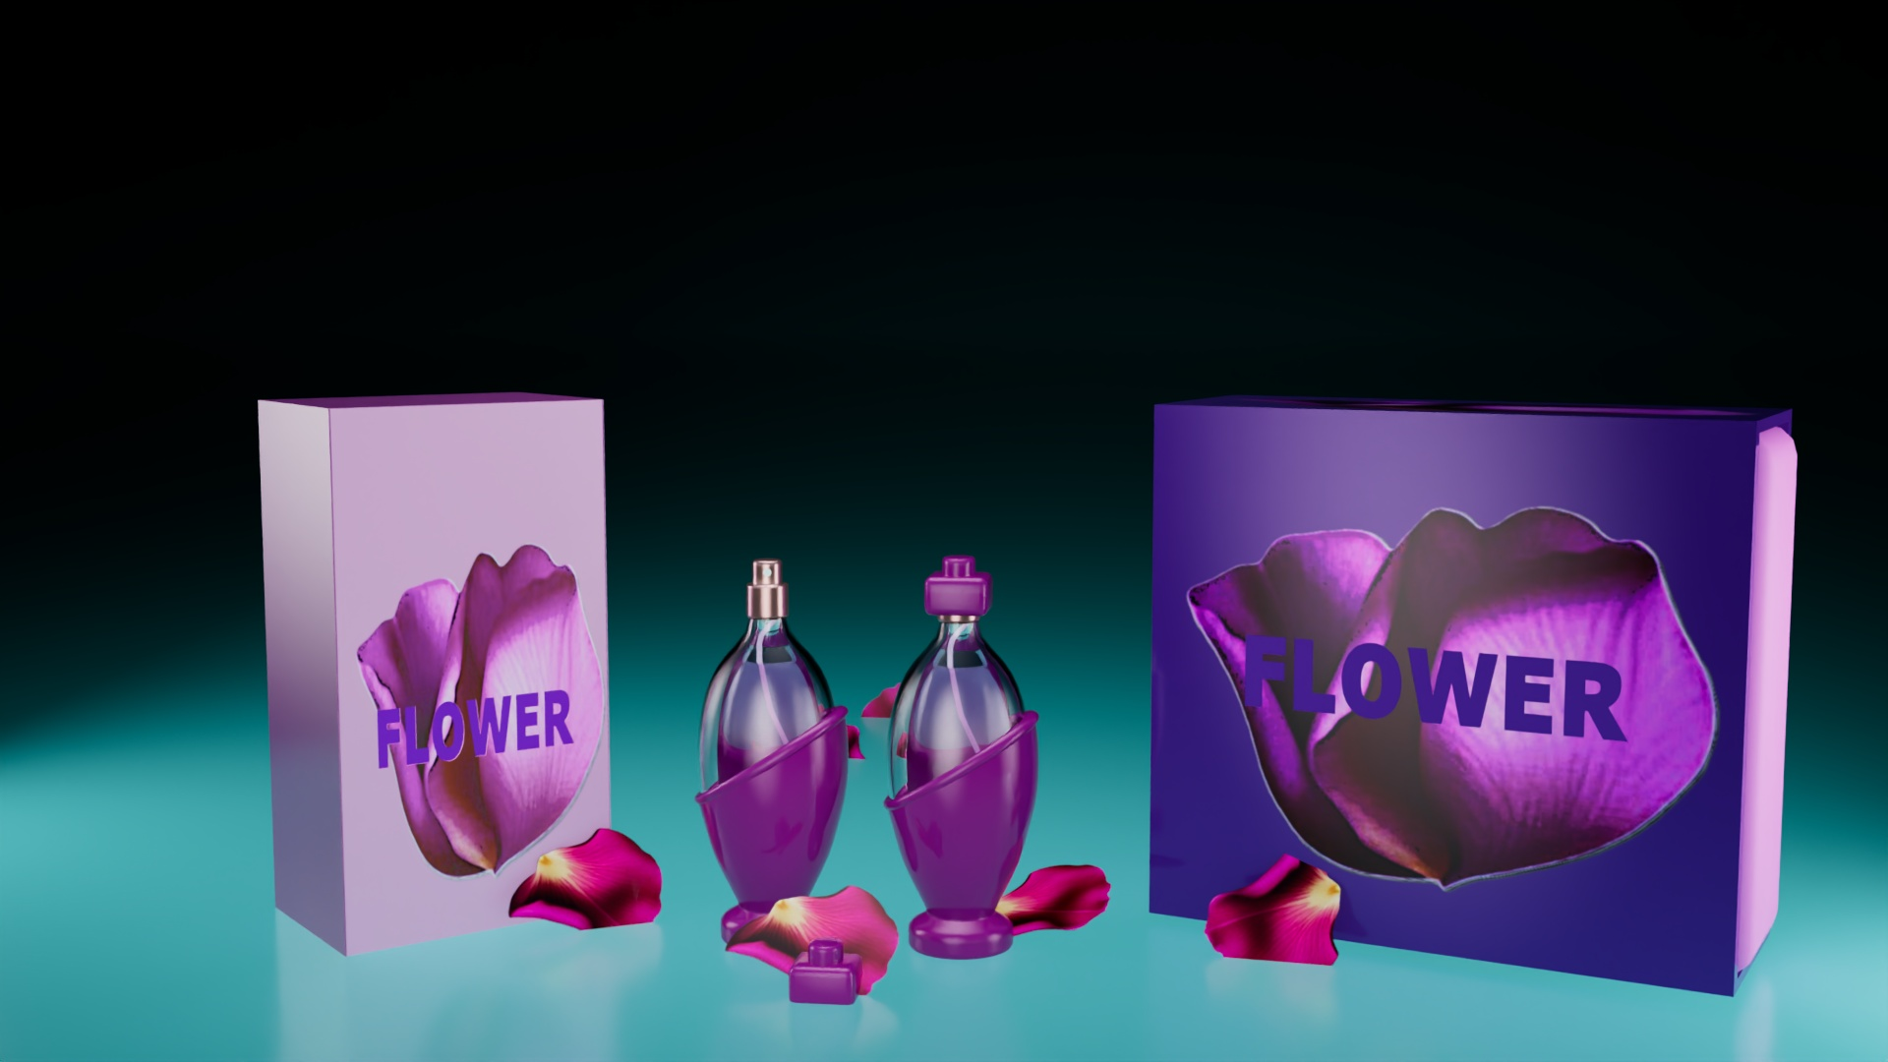
Project category
Product design
Perfume

Slide 3
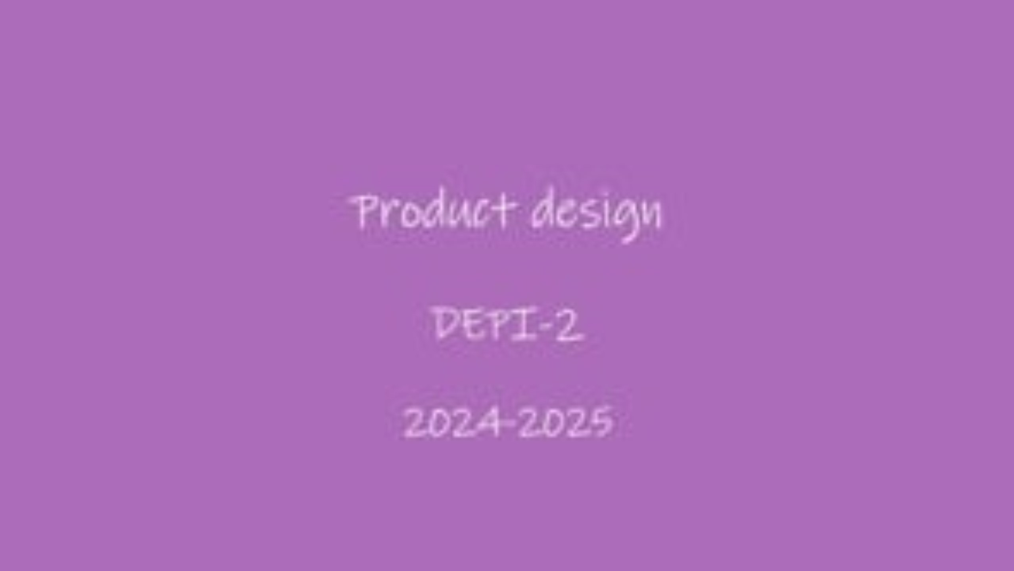

Slide 4
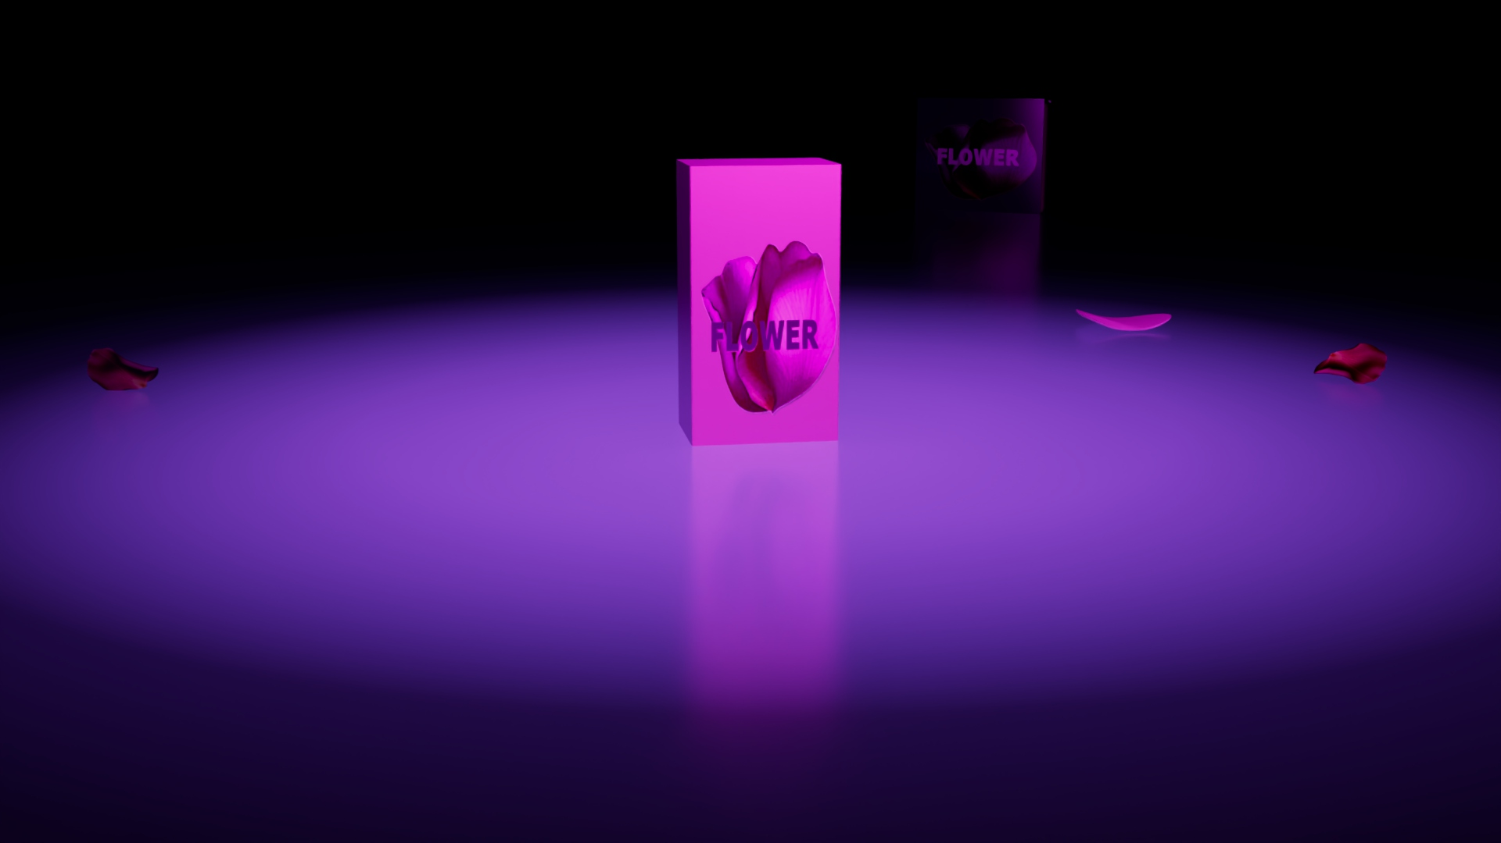
Stages of project :
Pre-production
Production
Post-production

Slide 5
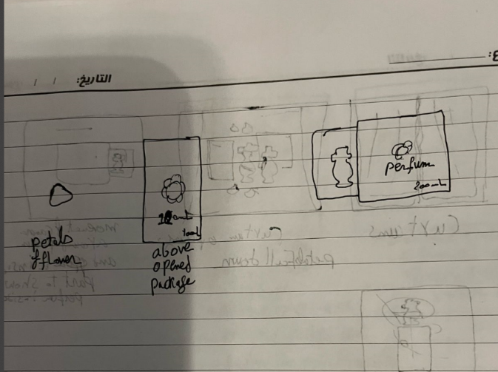
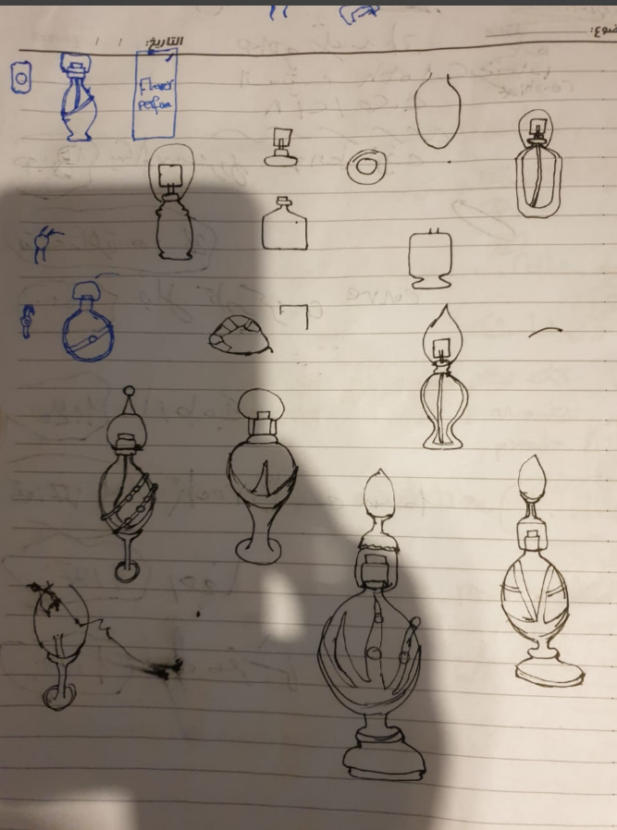
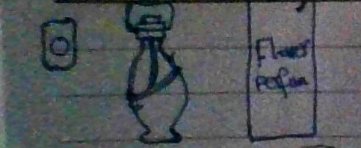
1-Pre-Production:
Product design sketching and ideas for perfume and its packages .

Slide 6
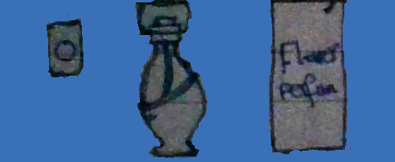
1-Pre-Production:
Choose perfume bottle design

Slide 7
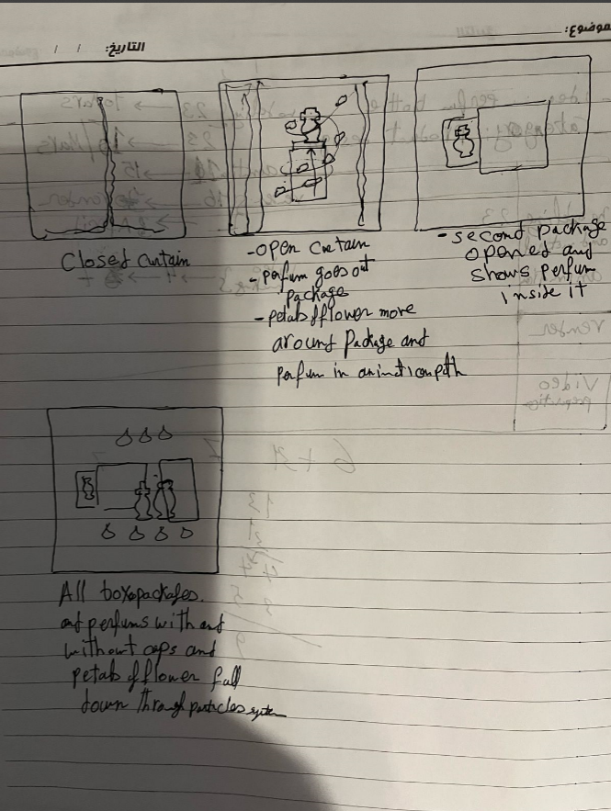
1-Pre-Production:
Making storyboard for animation of four scenes.
Imagine how to show and animate
the product in four scenes.

Slide 8
2-Production stage:
Scene Organization and Optimization:
  -Initially, all scenes were placed within a single 3ds Max file.
  Upon advice from our the supervisor and trainer, the project was split into four separate files, improving workflow efficiency, especially in lighting and rendering time .

Slide 9
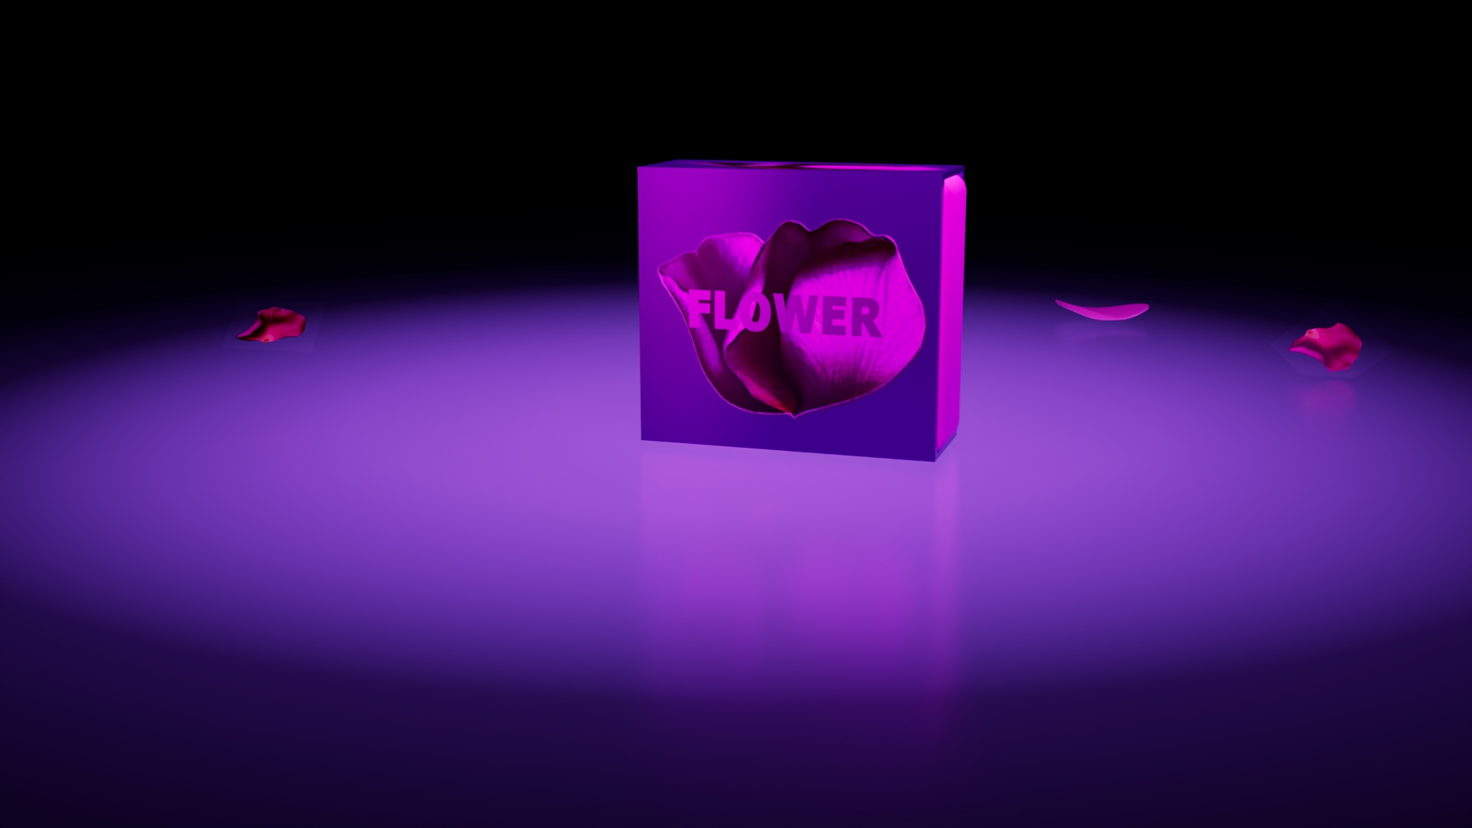
2-Production stage:
Tools:
-3D Software for modeling : 3d Max 2025
Models and material :
Perfume bottle ,Two package , Petal and curtain
Lighting : Studio light
Camera: Physical camera
Renderer: Arnold

Slide 10
2-Production stage:
Useful Modifiers and Solutions to Challenges:
Noise Modifier: Added complexity and realism to the curtain.
Cloth modifier: Simulating the motion of cloth as it interacts with the environment.
TurboSmooth Modifier: Smoothed models, increased polygons, and eliminated sharp edges.
Arnold Properties:
  Adjusted model interaction with specific lights.
  Enabled light inclusion/exclusion for enhanced visual control.
Edit Poly:
  Enhanced object control at sub-object levels (vertex, edge, polygon, and element).

Slide 11
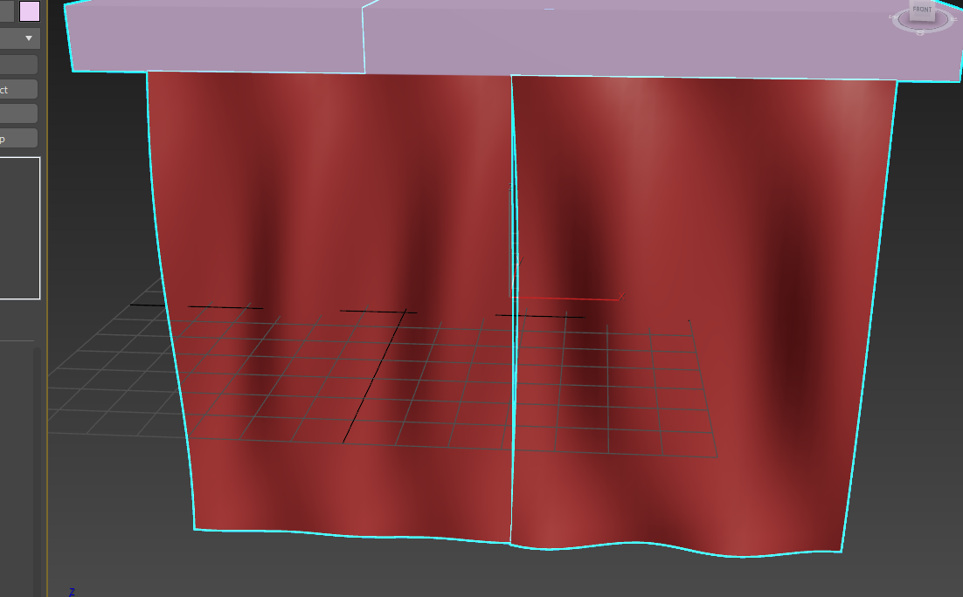

2-Production stage:
Curtain model and material :

Slide 12
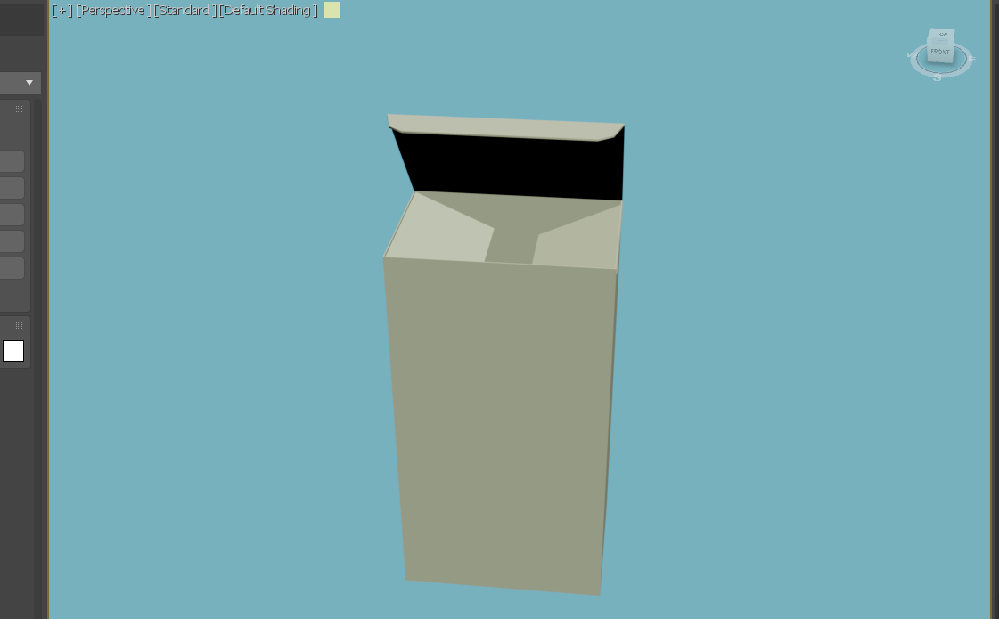
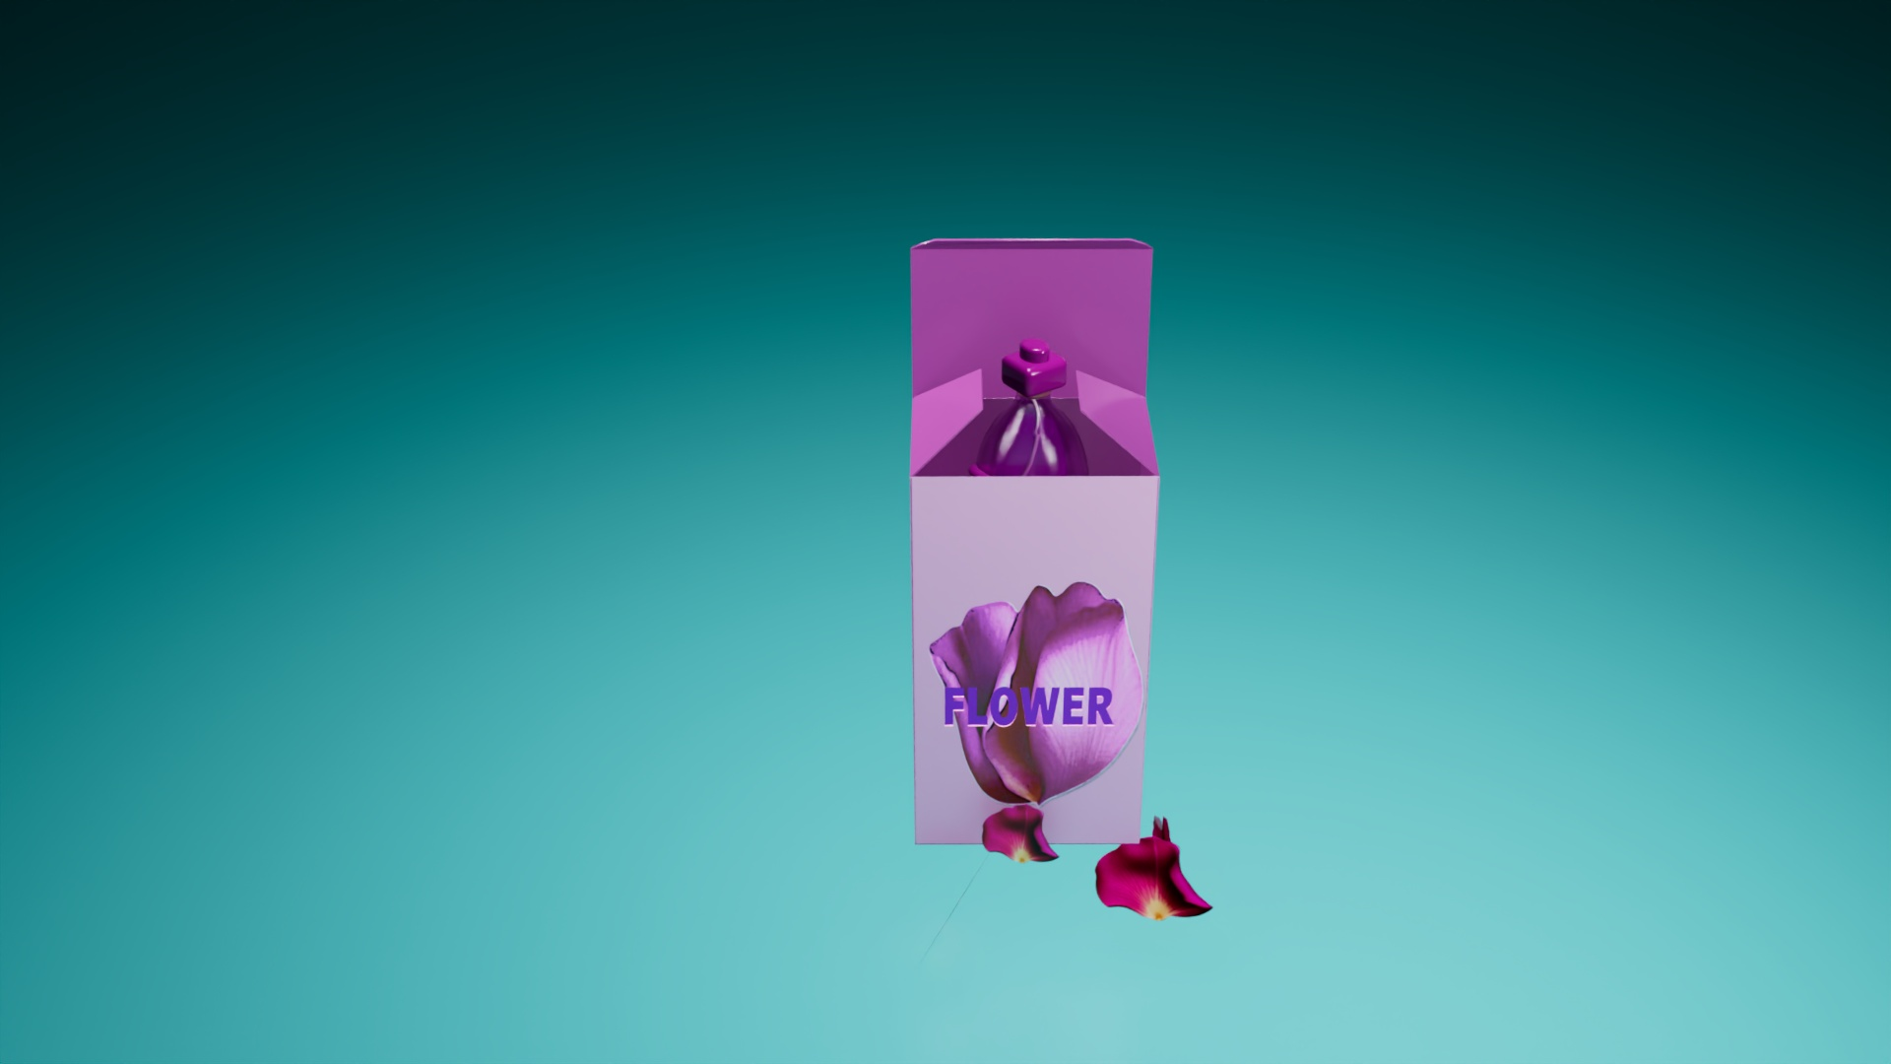
2-Production stage:
package models and material:

Slide 13
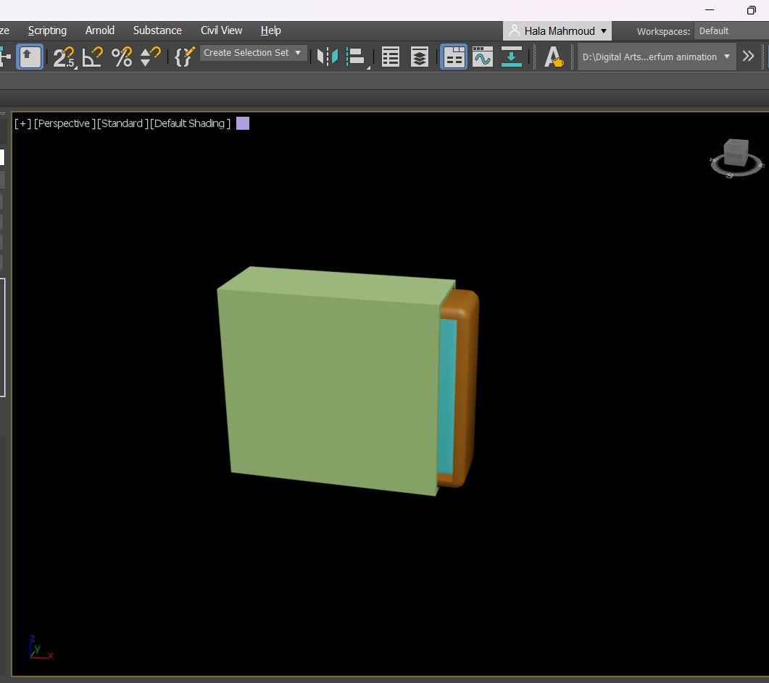

2-Production stage:
package models and material:

Slide 14
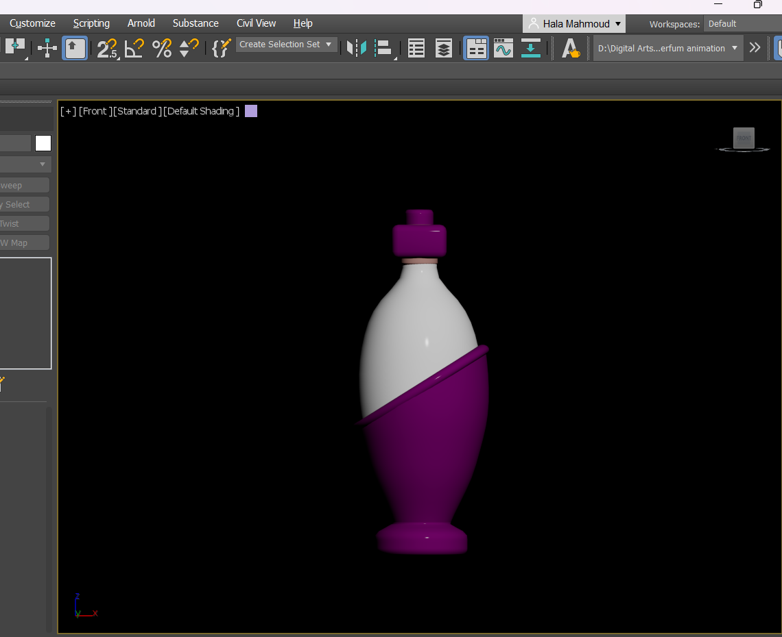
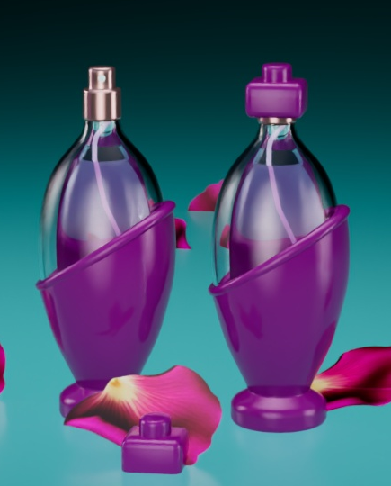
2-Production stage:
Perfume models and material:

Slide 15
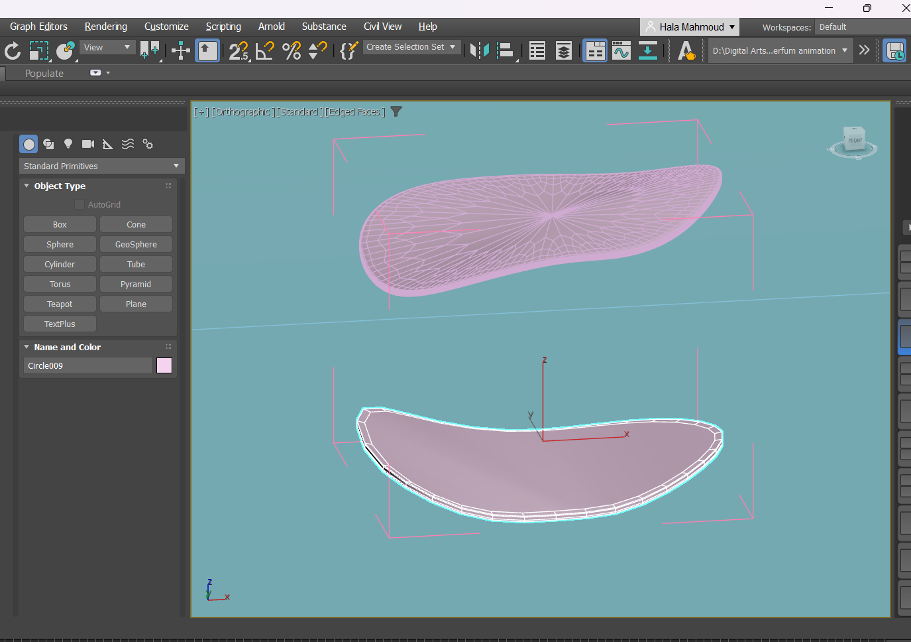
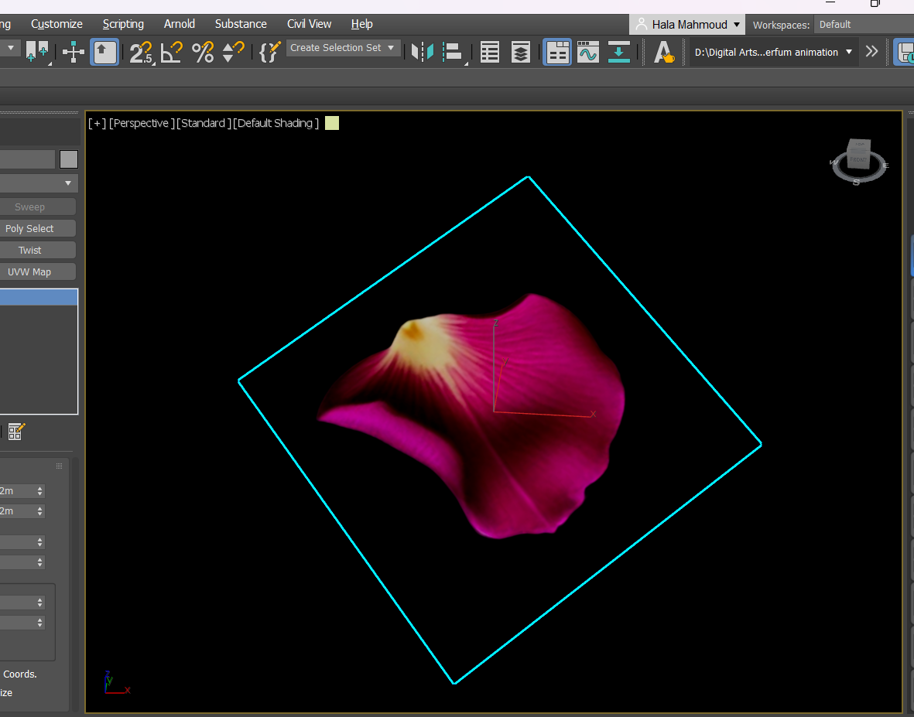
2-Production stage:
Petal model and material:
Create petal model was used in first scene
Main petals were created by plane with petal image on Bitmap lookup to decrease render time

Slide 16
2-Production stage:
Lighting and Background Setup
Lighting setup:
-Arnold Light Types:
  Quad (Plane Light) was used for studio lighting, consisting of key light, fill light, and rim light.
  Additional light was placed above models in the fourth scene.
-Photometric Light:
  A light file(IES profile) was uploaded in Photometric type in the first scene to achieve realistic illumination .

Slide 17
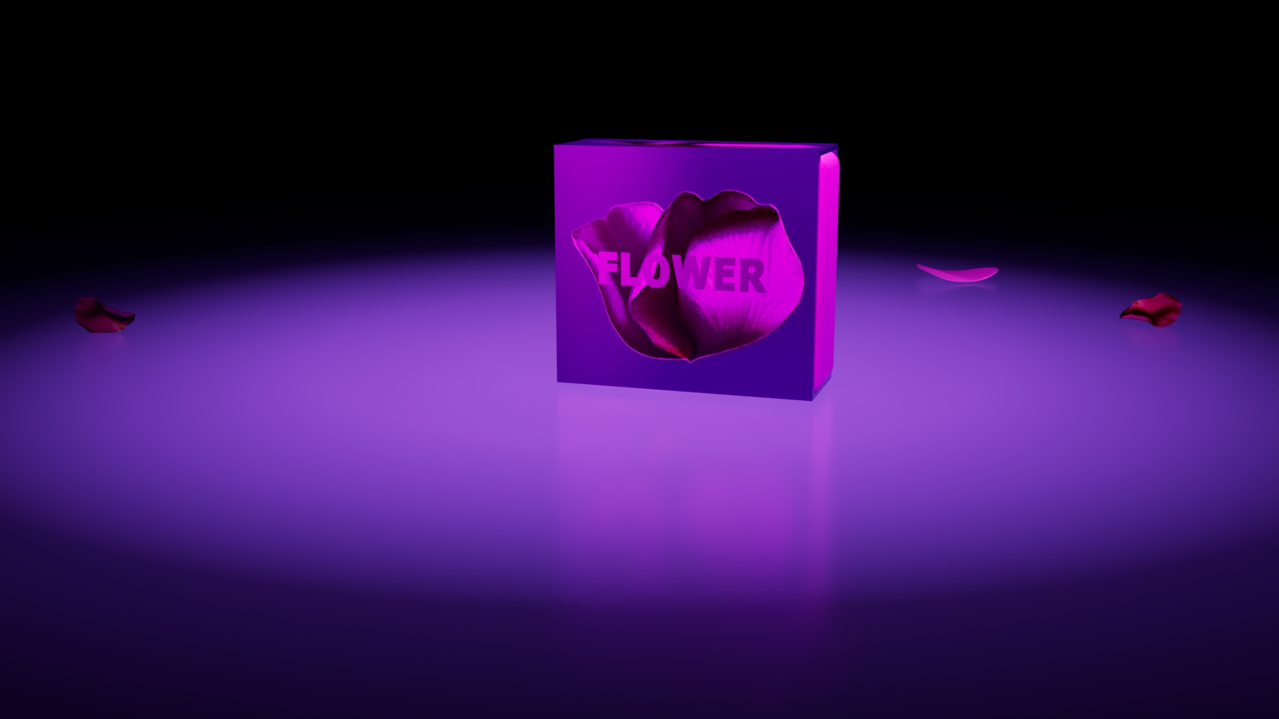
2-Production stage:
Background Setup:
-A plane was converted into an editable poly.
  -Edge modifications included chamfering the middle edge, increasing segments, and smoothing for curvature.

Slide 18
2-Production stage:
Animation:
Keyframe Animation: Applied to all four scenes directly on the timeline.
Total Keyframes: 1,299 frames across four scenes
Time Configuration settings:
-Frame rate: 30 FPS
-Format: NTSC
Path Constraint Animation:(in scene 2)
  Used to animate petals swirling around the perfume bottle in Scene 2.
  A helix spline was utilized as the animation path.

Slide 19
2-Production stage:
Curtain Animation: (in scene 1)
  Cloth modifier applied, simulated, and converted into keyframes.
Particle System: (in scene 4)
  PF Source was used to make petals fall from top to bottom.
  POmniFlect Deflector in space warps enabled petals to land realistically on the ground.

Slide 20
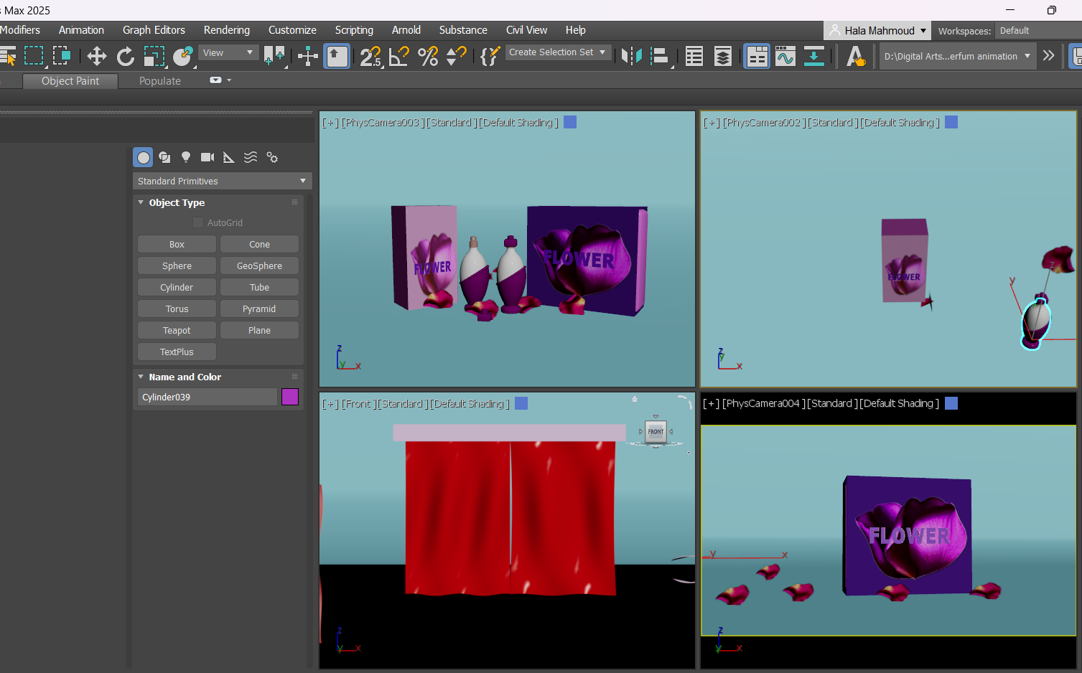
2-Production stage:
Camera and Rendering Setup:
Camera:
-Four standard Physical Cameras were used, with one camera assigned per scene.
Rendering:
-Renderer: Arnold
-Testing Mode: ActiveShade for testing material and lighting adjustments.
-Final Render Mode: Production Rendering
-Resolution: 1920x1080

Slide 21
3-Post-Production:
After I got render output for four scenes ,I used blender software as video editor to convert images into video for resolution 1920x1020.
Video duration : 1 minute and 15 seconds .
Add music for video that is owned by FesliyanStudios(Please DO NOT add this audio content to the Youtube Content ID System. I have used background music which is owned by FesliyanStudios).
Links of project folder :
https://drive.google.com/drive/folders/18whbIPtGyKf84e7hxLkdwa-WQ4h-mXxv?usp=sharing
Link of video:
https://drive.google.com/drive/folders/1fuqliVVU2t7p4bJSXl0PAMwR_4si2s_7?usp=sharing

Slide 22
Acknowledgments
I would like to thank my supervisor and trainer,
Engineer Ahmad Tawfiq
For his knowledge and efforts with us

Slide 23
Thanks

